Slide 1
SOCIAL DISTANCING INDICATOR AND ALARM SYSTEM

Slide 2
ABSTRACT
Internet of Things is a revolutionary domain that has the caliber to impact our lives and bring significant changes to the world. Now-a days social distancing is crucial for preventing the spread of viral diseases illnesses such as COVID-19. By minimizing the closely physical contact between people, we can reduce chances of catching the virus and spreading it to the community. But all the people are not following this social distancing so for this we are implementing a social distance detector, if any person has this detector this will help you if we are not maintain the distance between the people. Mainly we are creating this detector for BLIND people, because they are not able to see the persons before them, so from this detector they will easily maintain the distance. If the person is near to the another person then this detector will ring the buzzer like sound, so then it easily known to that blind person that he/she is near to the another person, then they will move aside from the person. This is very important for blind people.

Slide 3
CONCLUSION
More over the proposed solution is very useful for social distancing mainly for blind persons. COVID-19 outbreak is unprecedented and has disrupted lives of millions of people across the globe. This pandemic has opened several research challenges and opportunities that our community must address to equip itself for the future. The proposed architecture and the iot application is mainly assisted used to effectively and timely enforce social distancing community measures, and optimize the use of resources in critical situations .

Slide 4
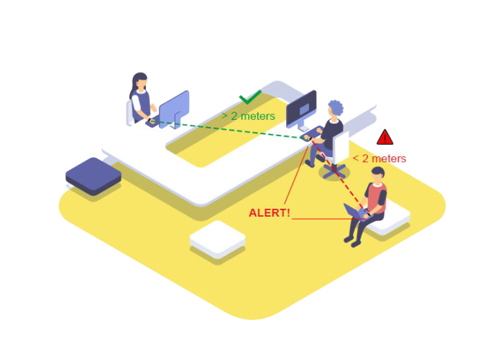
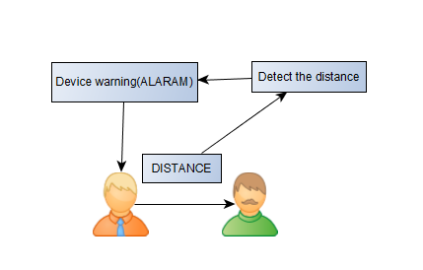
ARCHITECTURE DIAGRAM

Slide 5
MODULES
Input module:
Ultrasonic sensor is used to detect the objects which are near to it. And for this sensor alarm is attached to it which gives a sound when a person or any object is near to it
Computation module:
In this case the sensor will detect near by objects and if the object is coming into the particular distance where two persons should maintain the distance of some meters then it produces an alarm to the particular person then the person will stop walking to avoid contact
Output module:
The output is the alarm sound which will be produced to avoid contact

Slide 6
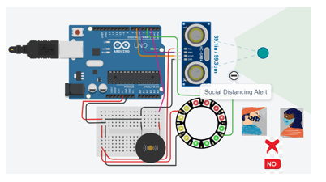
IMPLEMENTATION

